Slide 1
Linked open data for pesticides: PestOn ontology
Marco Mediciª, Damion Dooley^{b}, Maurizio Canavariª
ª Department of Agricultural and Food Sciences
Alma Mater Studiorum – University of Bologna, Italy
^{b} Centre for Infectious Disease Genomics and One Health Simon Fraser University, Canada

Slide 2
Table of contents
Context, aims and objectives
Methods and tools
Results
Observations

Slide 3
Pesticide information
Context, aims and objectives
Pesticide products are chemical agents used to protect crops from disease, pests, and weeds, and improve plant growth. Regulation of pesticides increased in the last decades mainly in Europe and North America to encourage a more appropriate use [1–4].
PRODUCTION Today pesticide producers are not required to disclose information such as pesticide data evaluation records, product inert ingredients and ingredient source [5]. In the EU, information about pesticides is only indirectly accessible, with an intermediate step involving the national authority [6].
USE Present regulations treat pesticides with a light touch, leaving users with scarce reporting requirements [7–9].

Slide 4
Linked open data
Context, aims and objectives
Yet, making pesticide information available to the public and improving pesticide use reporting systems would incentivize professional users to perform responsible pesticide use.
AIM To take advantage of data science tools to overcome information gaps characterising pesticides and food systems and provide better metrics to monitor pesticide information.
OBJECTIVE To design an ontology describing public pesticide registers so that pesticide characteristics contained therein can be easily accessible, interoperable, and jointly usable by food supply chain stakeholders.

Slide 5

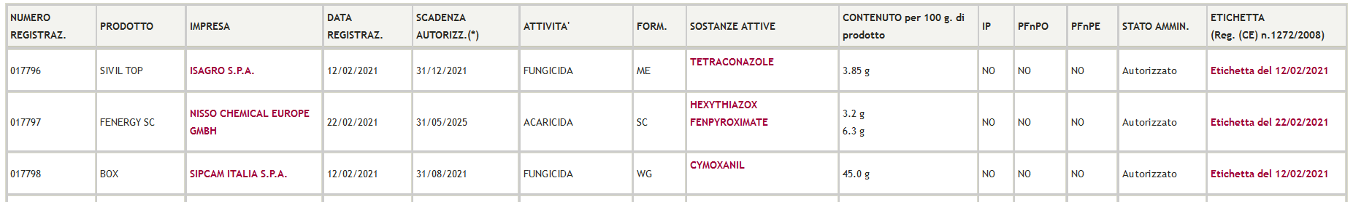
Methods and tools
DATA The public pesticide register issued by the Italian regulation authority comprising ~ 16,500 products was considered as starting point to build the ontology (a .csv file)
ATTRIBUTES A first scheme was designed to represent relations between concepts reported in the dataset. For each pesticide product, the following available attributes were considered: a) commercial name of the product b) list of active ingredients contained therein (name and concentration) c) chemical role (e.g., fungicide, insecticide, etc.) d) type of associated hazards e) product formulation f) producer company name; g) producer company location and h) address i) parallel importing (IP) and use by non-professional users j) issue date, k) expiry date, l) revocation date, and m) revocation decision date of the product; n) revocation reason, o) authorization status of the product (e.g., authorized, revoked, re-registered)

Slide 6
Methods and tools
ALIGNMENT To determine possible correspondences between concepts defined in other ontologies, the OBO Foundry framework approach was adopted [10,11]. Patterns were checked with: existing ontologies > other types of LOD > other existing standards:
a) commercial name of the product duct b) name and concentration of active ingredient(s) contained therein c) chemical role (e.g., fungicide, insecticide, etc.) d) type of associated hazards e) product formulation f) producer company name g) producer company location h) producer company address i) parallel importing (IP) and use by non-professional users (PFnPO, PFnPE) j) issue date, k) expiry date, l) revocation date, and m) revocation decision date of the product n) revocation reason, o) authorization status of the product (authorized, revoked, re-registered)
[new class]
CHeBI (via Zooma), UOM
CHeBI
GHS¹, EU legislation
CropLife International, IPARC²
NCIT
Wikidata (via Wikidata Query Service)
PostalAddress
[new classes]
[instant entities]
[new classes]
¹Globally Harmonized System of Classification and Labelling of Chemicals ²The International Pesticide Application Research Consortium, Department of Biology, Imperial College, London
IMPLEMENTATION PestOn was implemented using ROBOT template; the initial dataset was progressively imported into the ontology using OntoFox, fetching terms and axioms. Then, Protégé was used to verify the syntax correctness and possible undesired results from reasoning.

Slide 7
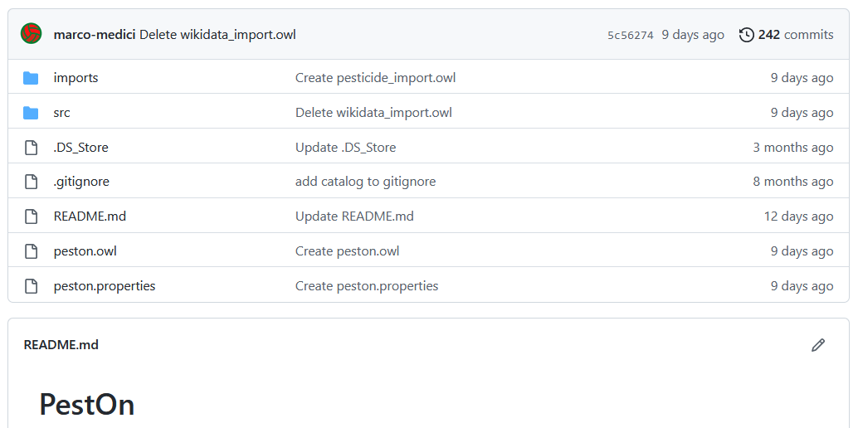
Results
ALIGNMENT OUTCOMES >99% of the entities were successfully matched against CHeBI (exceptions: terms referring to organic entities distinct form chemical compounds -fungi, bacteria, terms not tracked in CHeBI)
MAIN FIGURES -1957 classes -795 active ingredients contained in 16,458 pesticide products -532 producer companies
Freely available on GitHub: http://github.com/marco-medici/peston
Scientific article: An Ontology to Make Pesticides Information Easily Accessible and Interoperable https://doi.org/10.3390/su14116673

Slide 8
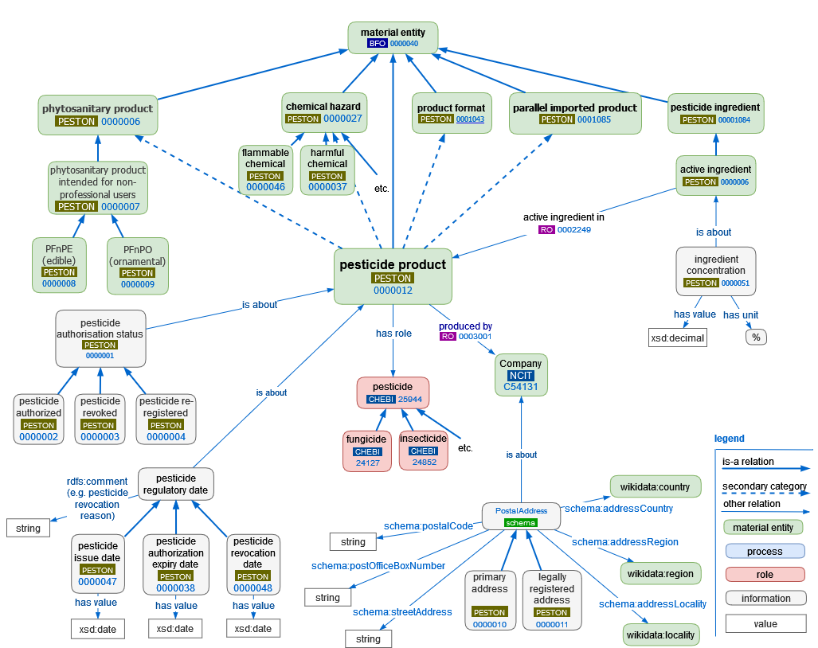
Results
In PestOn, the information describing a certain entity can be aggregated across multiple dimensions
For example:
overview of the current available products for each role;
summary of products containing a given active ingredient;
...

Slide 9
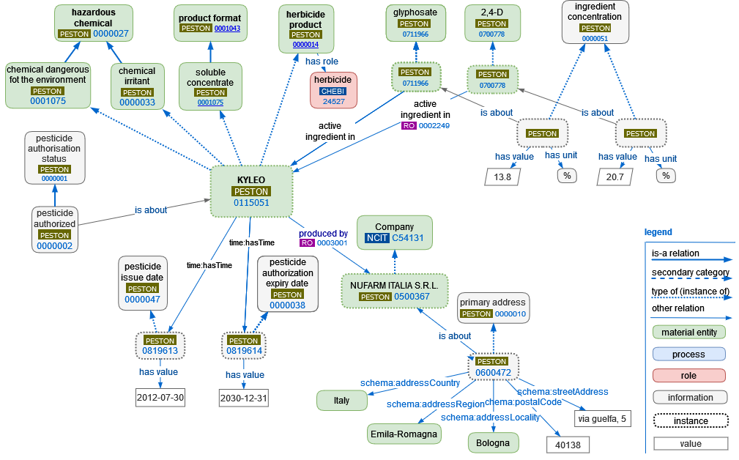
Results
- Overview of a sample herbicide product KYLEO:

Slide 10
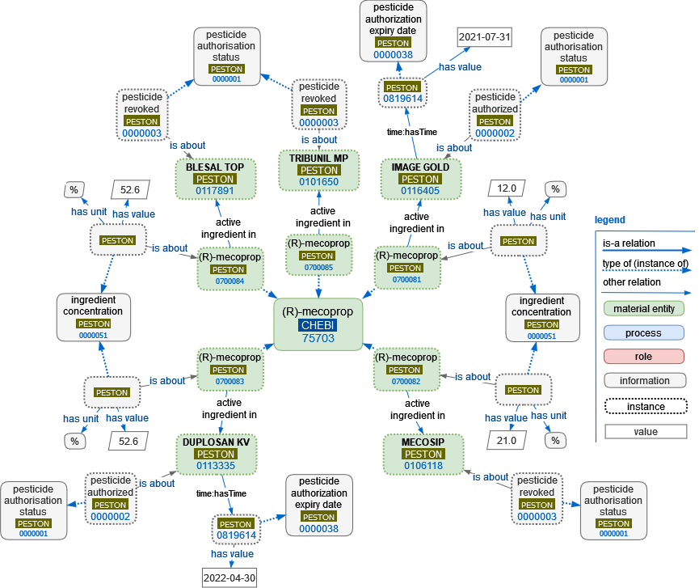
Results
- Products containing the active ingredient (R)-mecoprop: (info about product authorization status)

Slide 11
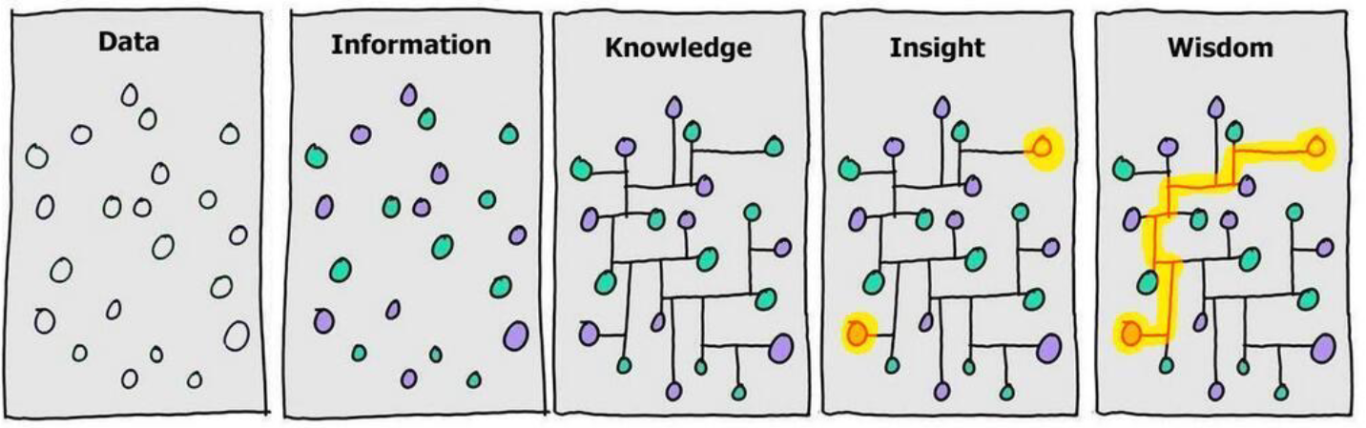
Observations
INTRINSIC ADVANTAGES OF SEMANTIC TECHNOLOGY - A step toward FAIRness; - A step toward ‘wisdom’ in DIKW paradigm:
POSSIBLE BENEFITS FOR VALUE CHAINS - Ensuring dynamic interoperability, needed to best implement traceability, quality and food safety of inputs and final products, LOD can improve the flow of information of food production inputs; - Automatic compliance: LOD can help supply chain actors to more efficiently comply with particular regulations and distinct farming approaches (e.g., organic, GLOBALG.A.P., integrated production); - Smart labels e product attributes: consumers may benefit from the information describing where, when, and how food is produced, in this case by tracking back types and amounts of input used [12]; - Interconnection with other domains (agronomic, industrial, environmental, nutritional, etc.) thanks to a shared language: PestOn can be beneficial to health literature focusing on individuals directly exposed to pesticides, it can support investigations about productivity-health trade-offs [13,14], it can be easily matched with tools for the estimation of the external costs of pesticide use [15], it can be connected with other ontologies in the domain of human and environmental exposure to stressors (e.g., ECTO).
Notes:
Per gli attori della filiera e ed altri stakeholders del settore agro-alimentare
LOD può aiutare gli attori della catena di approvvigionamento a conformarsi in modo più efficiente a normative particolari e approcci agricoli distinti (ad es. agricoltura biologica, agricoltura integrata). Anche i consumatori possono trarre vantaggio dalle informazioni che descrivono dove, quando e come viene prodotto il cibo, in questo caso rintracciando i tipi e le quantità di input utilizzati nei processi di produzione.
L'apertura di dati nel dominio degli input agricoli e il raggiungimento dell'interoperabilità tra il dominio agro-alimentare ed altri domini può rappresentare un primo passo per rendere disponibili informazioni in modo più efficiente ed efficace, con numerosi vantaggi. Ad esempio, gli attori della filiera possono beneficiare di processi standardizzati per conformarsi agli standard di produzione (es. agricoltura biologica, agricoltura integrata); i consumatori possono rintracciare le quantità di input utilizzate durante i processi di produzione, verificando così le informazioni su dove, quando e come è stato prodotto il cibo. Inoltre, gli schemi di conformità automatici basati su LOD possono facilitare i meccanismi di valutazione di terze parti come le normative sulla sicurezza alimentare, le valutazioni del ciclo di vita, gli approcci agricoli regolamentati, solo per citarne alcuni. Altri benefici derivano dall'esaurimento delle risorse in agricoltura per quanto riguarda l'energia, i nutrienti, l'acqua, il suolo e la terra

Slide 12
Main references
1. Böcker T, Finger R, González De Molina M, et al. (2016) European Pesticide Tax Schemes in Comparison: An Analysis of Experiences and Developments. Sustain 2016, Vol 8, Page 378 8: 378. 2. Goldman LR (2002) Preventing Pollution: U.S. Toxic Chemicals and Pesticides Policies and Sustainable Development. Environ Law Report News Anal 32. 3. RPA (1997) Risk and Policy Analysts. Private Costs and Benefits of Pesticide Minimisation. Report to Department of the Environment: London. 4. ECOTEC (1997) Economic Instruments for Pesticide Minimisation; Report to the Department of Environment: London. 5. Limitations on Disclosure of Information under Pesticide Law | US EPA Available from: https://www.epa.gov/foia/limitations-disclosure-information-under-pesticide-law. 6. Regulation EC No 1107/2009 of the European Parliament and of the Council of 21 October 2009 concerning the placing of plant protection products on the market and repealing Council Directives 79/117/EEC and 91/414/EEC. Available from: https://eur-lex.europa.eu/legal-content/EN/TXT/?uri=celex%3A32009R1107. 7. Jacobson B (2011) Making Pesticides Public: A Disclosure-Based Approach to Regulating Pesticide Use. Minn L Rev 96: 1123. 8. Ruhl JB (2000) Farms, Their Environmental Harms, and Environmental Law. Ecol Law Q 27: 263–348. 9. Broad Leib EM, Pollans MJ, Babcock H, et al. (2019) The New Food Safety. Calif Law Rev 107: 1173. 10. Dooley D, Andrés-Hernández L, Bordea G, et al. (2021) Obo foundry food ontology interconnectivity. CEUR Workshop Proc 2969. 11. Smith B, Ashburner M, Rosse C, et al. (2007) The OBO Foundry: coordinated evolution of ontologies to support biomedical data integration. Nat Biotechnol 2007 2511 25: 1251–1255. 12. Reeves WR, McGuire MK, Stokes M, et al. (2019) Assessing the Safety of Pesticides in Food: How Current Regulations Protect Human Health. Adv Nutr 10: 80–88. 13. Sheahan M, Barrett CB, Goldvale C (2017) Human health and pesticide use in Sub-Saharan Africa. Agric Econ 48: 27–41. 14. Ye M, Beach J, Martin JW, et al. (2013) Occupational Pesticide Exposures and Respiratory Health. Int J Environ Res Public Heal 2013, Vol 10, Pages 6442-6471 10: 6442–6471. 15. Leach AW, Mumford JD (2008) Pesticide Environmental Accounting: A method for assessing the external costs of individual pesticide applications. Environ Pollut 151: 139–147.

